Slide 1
Telemetry Indexer
Zijian Chen, Yongxuan Fu, Wei Li, Zhuo Wang, Zi Yang

Slide 2
Background — Telemetry Indexer Project
Transform files into JSON format
Build an index that supports filtering and other operations
Design and implementation of a indexer and indexing structure depends on the workload and query patterns.

Slide 3
Data Preprocessing
Data Type: Log data from Mozilla Thunderbird.
Size: ~35GB
Event logs in general are a timestamp and a payload of some context.
Implemented batch reading and processing for large datasets

Slide 4
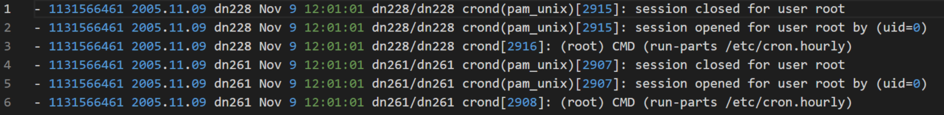
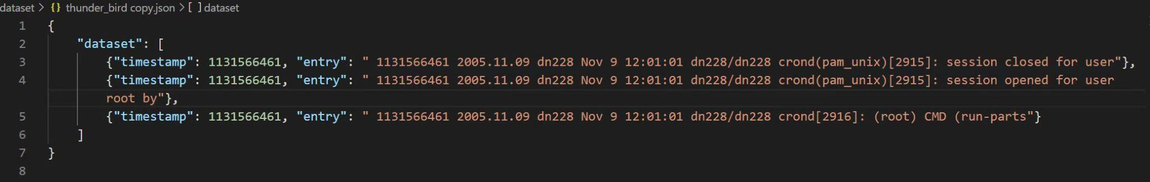
Raw Data
Preprocessed Data in JSON Format

Slide 5
Data Storage — LMDB
A B+tree-based database management library. The entire database is exposed in a memory map, and no malloc's or memcpy's occur during data fetches.
Relies on the OS/filesystem cache, no wasted memory in app-level caching.
Can store live pointer-based objects directly using a fixed address map.
Notes:
The storage size of the visual environment depends on your machine storage. Default: 10 MB. Single key and value size maximum: 4 GB.

Slide 6
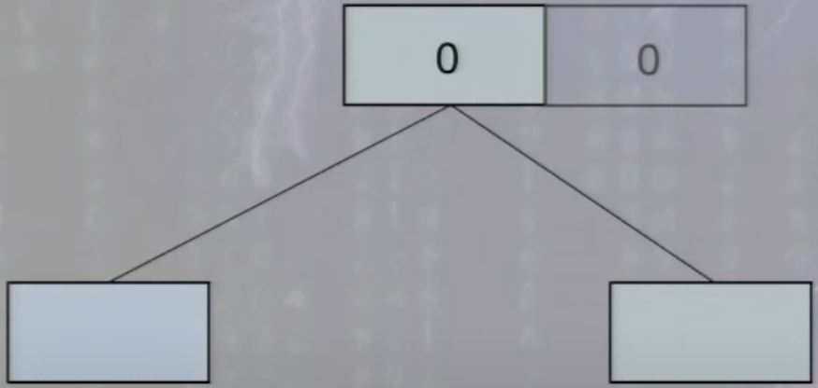
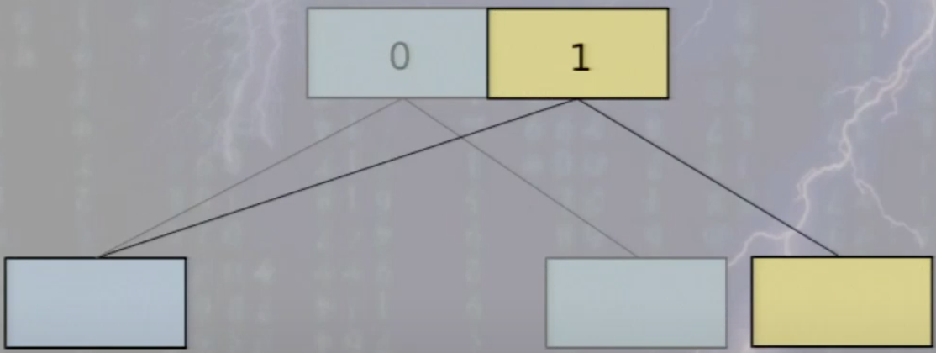
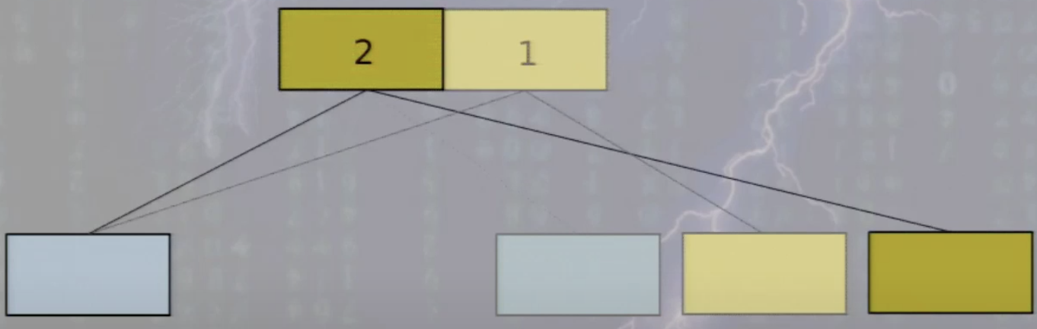
B+ -Tree Operation in LMDB
After this step the old blue page is no longer referenced by anything in the database, so it can be reclaimed.
Notes:
Using 2 fixed root nodes. https://www.youtube.com/watch?v=tEa5sAh-kVk

Slide 7
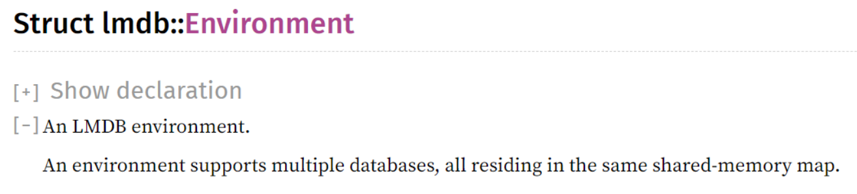
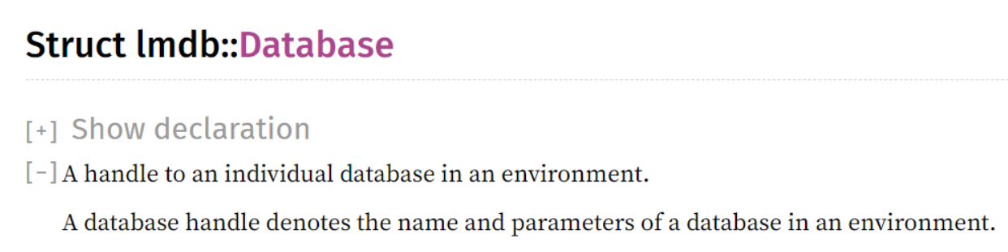
Structs in LMDB
environment
database

Slide 8
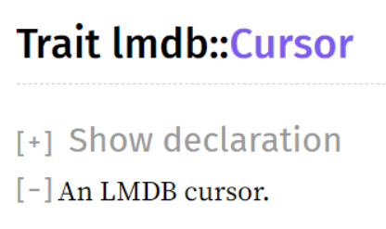
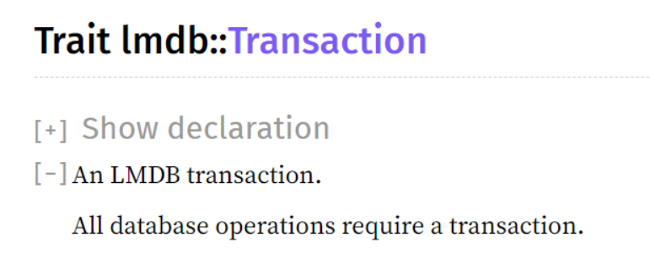
Structs in LMDB
Cursor
Transaction

Slide 9
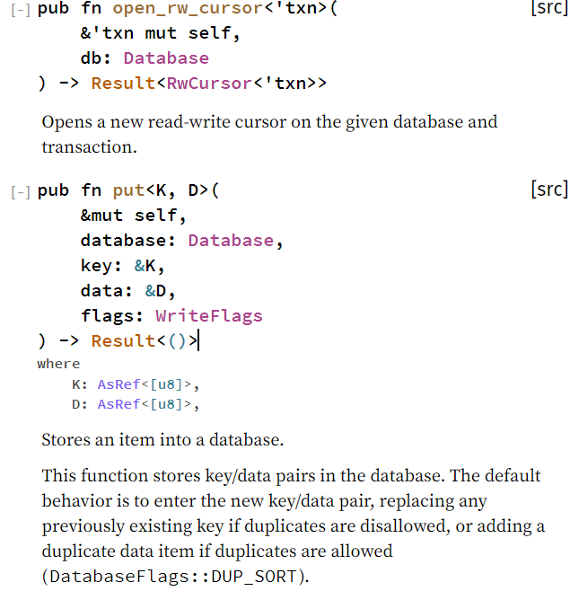
Functions in LMDB
RwTransaction

Slide 10
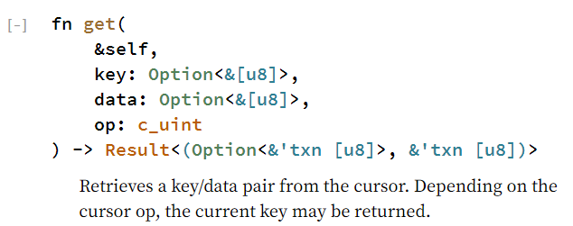
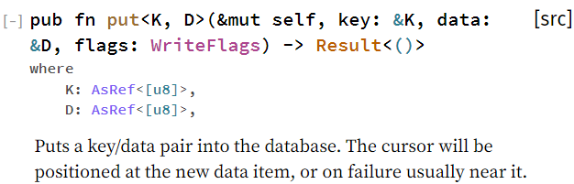
Functions in LMDB
RwCursor

Slide 11
Design and Testing
Implemented by us:
LMDB with nested B-Tree structure
LMDB with single B-Tree structure
Other Indexer for performance comparison:
Lucene Search Engine Library

Slide 12
LMDB with Nested B-Tree Structure
LMDB
Key: time interval
Value: B-Tree
Key: time stamp
Value: Content at the corresponding time stamp

Slide 13
LMDB with Nested B-Tree Structure — Index Design
1st level index: store time interval as key value in LMDB after batch reading and processing
In LMDB, each value is implemented as a B-Tree
2nd level index: store specific timestamp as key value in B-Tree structure (the value of LMDB)

Slide 14
LMDB with Single B-Tree Structure
LMDB
Key: time interval
Value: String
Use grep for data retrieval

Slide 15
Lucene
Lucene offers powerful features like scalable and high-performance indexing of the documents and search capability through a simple API. It utilizes powerful, accurate and efficient search algorithms written in Java.
The Lucene search API takes a search query and returns a set of documents ranked by relevancy with documents most similar to the query having the highest score. Lucene provides a highly configurable hybrid form of search that combines exact boolean searches with softer, more relevance-ranking-oriented vector-space search methods.
Notes:
Inverted Indexer, provides a mapping from terms to documents, The inverted index provides the mechanism for scoring search results

Slide 16
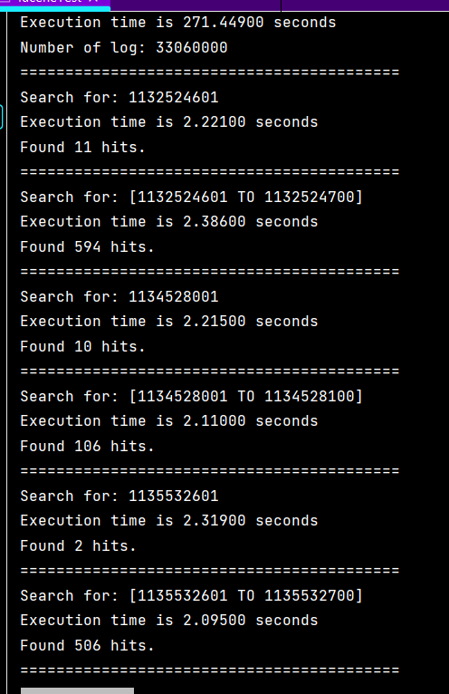
Results — Lucene
Time for adding log into indexer
Example Result

Slide 17
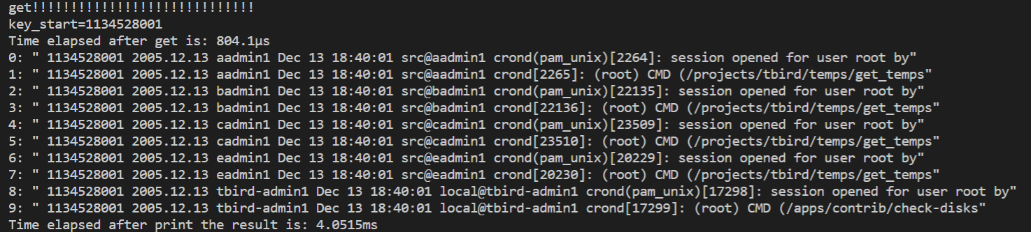
Results — LMDB with Nested B-Tree Structure

Slide 18
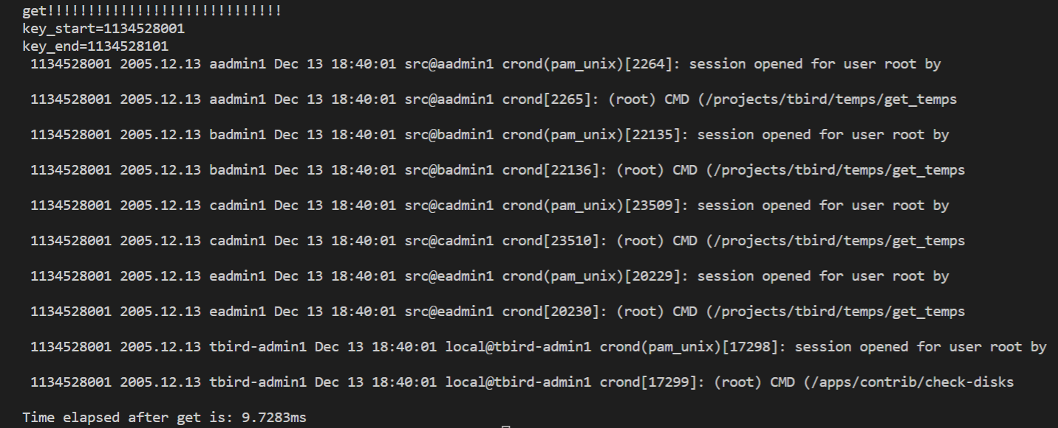
Results — LMDB with Single B-Tree Structure

Slide 19
Compare with Lucene
Storage
Lucene currently we use temporary search, can only store about 5 GB to heap
LMDB stores data into disk, we can set the maximum size for it.
Store Time
Lucene: 271.449s (5GB)
LMDB (nested B-Tree structure): 153s (5GB), 1100s(35GB)
LMDB (single B-Tree structure): 142s (5GB), 1037s(35GB)

Slide 20
Results — Query for Single Timestamp (5GB)
 | Average Executing Time
Lucene | About 2.2s
LMDB with nested B-Tree structure | Less than 1ms
LMDB with Single B-Tree structure | About 5-? ms (based on number of logs at that time)

Slide 21
Results — Query for Fixed Time Interval (5GB)
 | Average Executing Time
Lucene | About 2.2s
LMDB with nested B-Tree structure | Less than 1ms
LMDB with Single B-Tree structure | About 1ms

Slide 22
Results — Query for Single Timestamp (35GB)
 | Average Executing Time
LMDB with nested B-Tree structure | 1-2ms
LMDB with Single B-Tree structure | About 6-? ms (based on number of logs at that time)

Slide 23
Results — Query for Fixed Time Interval(35GB)
 | Average Executing Time
LMDB with nested B-Tree structure | 1-2ms
LMDB with Single B-Tree structure | About 2ms

Slide 24
Future Work
Find other data structure that may improve the storage and search performance.
Find other index that can arrange timeseries data efficiently.

